Slide 1

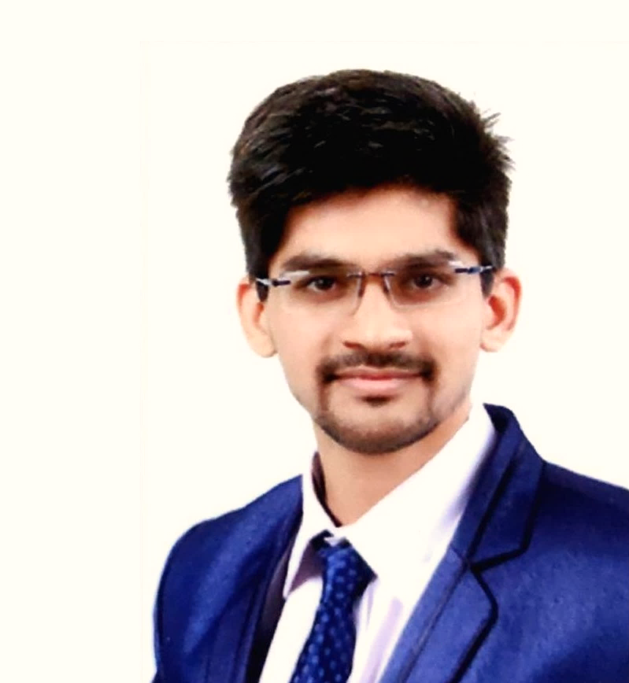
SHUBHAM RAJPUT
WEB DEVELOPER, JAVA DEVELOPER, DATA ANALYST

Slide 2



SHUBHAM BHAGWANSING RAJPUT
( Data Analyst, Web Developer, Java Developer )
Data Analyst, Web Developer, Java Developer
ABOUT
EDUCATION-1
EDUCATION
PERMANENT ADDRESS
HOBBIES
EDUCATION-2
- PCCOE
New Samrat Colony, Old Mehrun Road, Plot No. 71, Jalgaon - 425001
- Technical Writing
Singing
Playing Guitar
present
EXPERIENCE
RESEARCH 1
LOCAL ADDRESS
DATE OF BIRTH
- GPJ
16 December, 2000
RESEARCH 2
2016-2019
Near Akurdi Railway Station RD, Nigadi Road, Sector No. 26, Pradhikaran, Nigadi - 411044
INTEREST
CONTACT
- R. R. Vidhyalaya
EMAIL
LANGUAGES
2010-2015
shubham.rajput0369@gmail.com
English
Hindi
Marathi

Slide 3
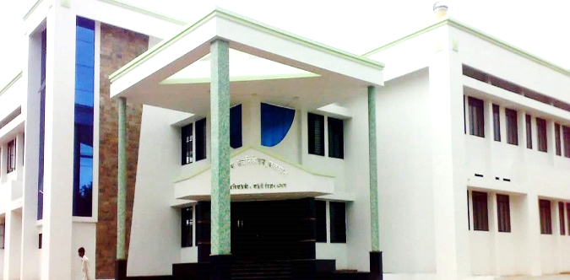
GOVERNMENT POLYTECHNIC, JALGAON
(GPJ)
I completed my degree of diploma in Information Technology from Government Polytechnic, Jalgaon.
PHOTO
GRADE
PROJECTS
ABOUT
86.06%
First Class with Distinction
Exam Management System (EMS)
EDUCATION-1
EDUCATION-2
EXPERIENCE
PROGRAMMING LANGUAGES
SKILLS
AWARDS & PRIZES
Leadership
Management
Problem Solving
Best Anchor of The GPJ.
Awarded by Attarde Classes for academic achievement.
RESEARCH 1
C Programming
C++ Programing
Java Programming
RESEARCH 2
INTEREST
CERTIFICATIONS
ACTIVITIES
CONTACT
Programming in C
Programming in C++
Java Programming
Abhirang 2017 main co-ordinator & main anchor.
1st rank in anchoring in “Abhirang 2017“.
Member of "Guidance for Needed” (charity trust's of president Mr. Parag Attarde sir).
Technofest 2k16 & Technofest 2k17 Volunteer.

Slide 4
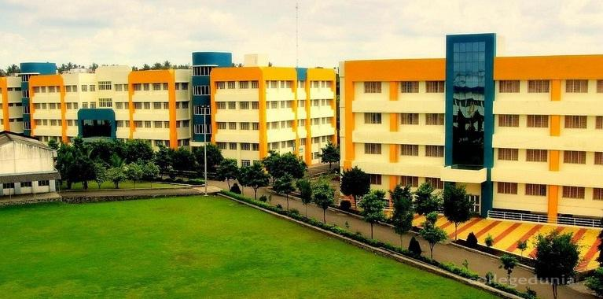
PIMPRI CHINCHWAD COLLEGE OF ENGINEERING, PUNE
(PCCOE)
I am currently pursuing my bachelor of engineering degree in Computer Engineering from Pimpri Chinchwad College of Engineering, Pune.
PHOTO
GRADE
PROJECTS
ABOUT
8.98 SGPA
First Class with Distinction
Water Management System
EDUCATION-1
EDUCATION-2
EXPERIENCE
PROGRAMMING LANGUAGES
SKILLS
C Programming
C++ Programing
Java Programming
Python Programming
R Programming
HTML, CSS, JavaScript
Bootstrap
PHP, MySQL
Node.js
Leadership
Management
Problem Solving
RESEARCH 1
RESEARCH 2
INTEREST
CERTIFICATIONS
ACTIVITIES
CONTACT
Web Development 2020 Build 15 Projects (Bootcamp)
Python Programming (Specialization)
Data Science (Specialization)
R Programming
Participated in IOT Challenge 2020 Certified by IIT Bombay and i3indya.
Participated in ICT Academy New India Learnathon 2020.
Member of CodingClubIndia to explore the Indian "World of Coding".
Volunteer at T&P Cell of PCCOE, Pune.
Participated in Art Circle PCCOE, Pune.

Slide 5
EXPERIENCE
PERFECT SKILLS – Web Developer
July 2020 -present
At PERFECT SKILLS, I work for developing client’s websites with HTML, CSS, JavaScript, MySQL & PHP.
ABOUT
Professional web-portfolio using HTML, CSS, JavaScript & Bootstrap.
Client’s project of developing website using HTML, CSS, PHP, JavaScript & Bootstrap.
EDUCATION-1
EDUCATION-2
ANALYTICS VIDHYA – Technical Writer
June 2020 -present
EXPERIENCE
At ANALYTICS VIDHYA, I researching on the concept of Big Data & data science for innovating strong research.
“Big Data Applications: The Influencer”
“Big Data 3 V’s & 5 V’s”
“What is Big Data?”
RESEARCH 1
RESEARCH 2
ROZBUZZ WEMEDIA – Technical Writer
May 2020 -present
INTEREST
CONTACT
At ROZBUZZ WEMEDIA, I worked on content development and technology research domain.
“Do we really need 5-G Technology?”
“How technology can be used to face Nisarga cyclone?”
“The relationship between Human & Technology”
“Is technology really limiting the creativity?”

Slide 6
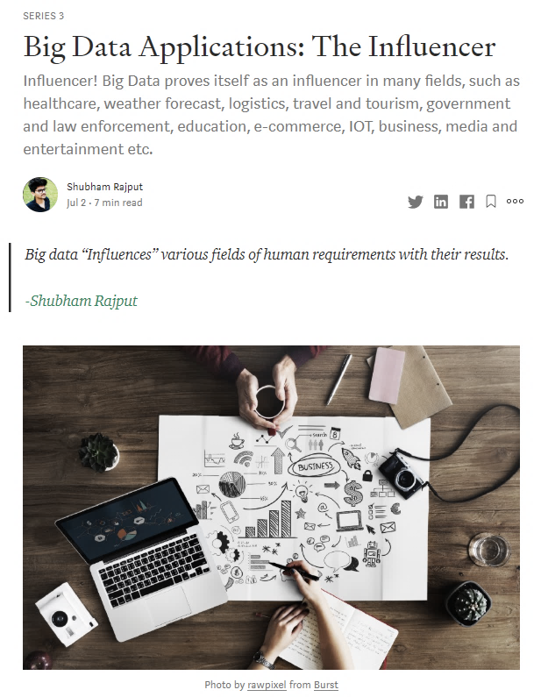
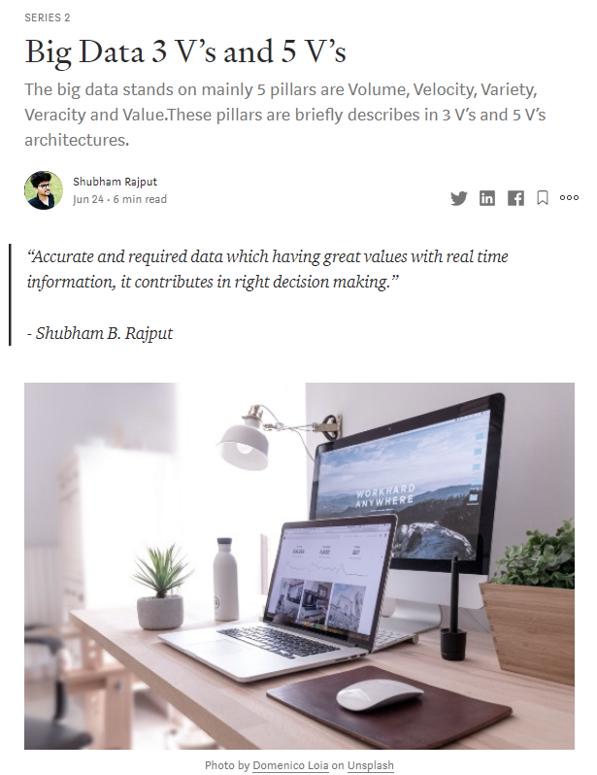
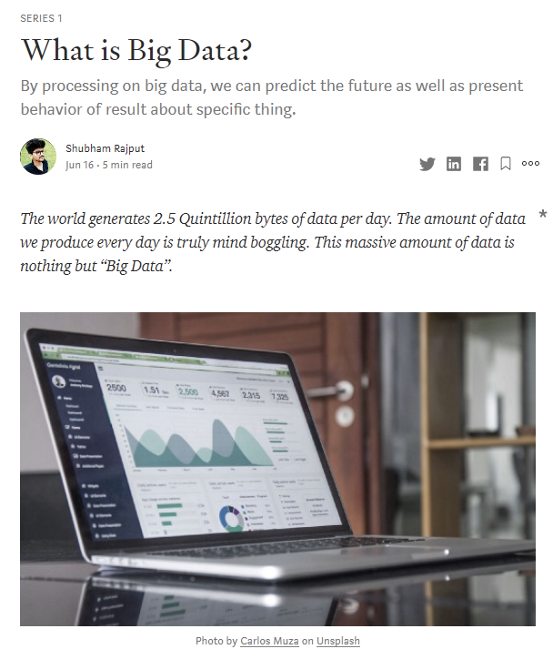
RESEARCH
I recently started to publish a series of “Big Data”. This whole series explores the concepts, applications, technologies, architecture & prediction technics of “Big Data”.
ABOUT
EDUCATION-1
EDUCATION-2
EXPERIENCE
RESEARCH 1
RESEARCH 2
INTEREST
CONTACT
This series explains various applications of “Big Data” as it influences many fields for e.g. E-commerce, IOT, Media & Entertainment, Healthcare etc.
It demonstrated structure and behavior of “Big Data”.
Big Data stands on mainly 5 pillars i.e. Volume, Velocity, Variety, Veracity & Value.
“What is Big Data?” is the inception series of “Big Data”. It explains Big Data concept with real time application basis examples.

Slide 7
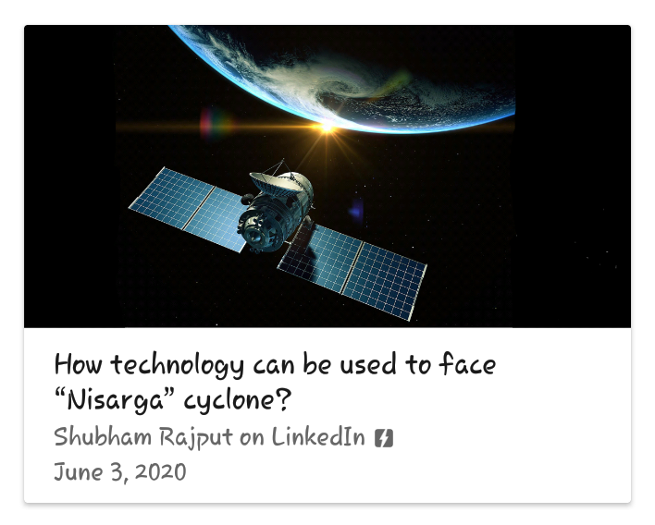
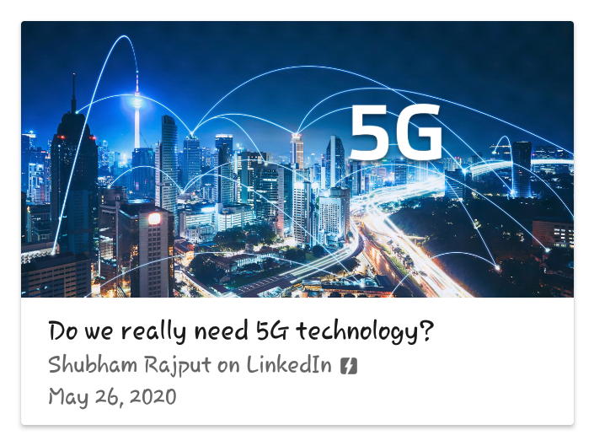
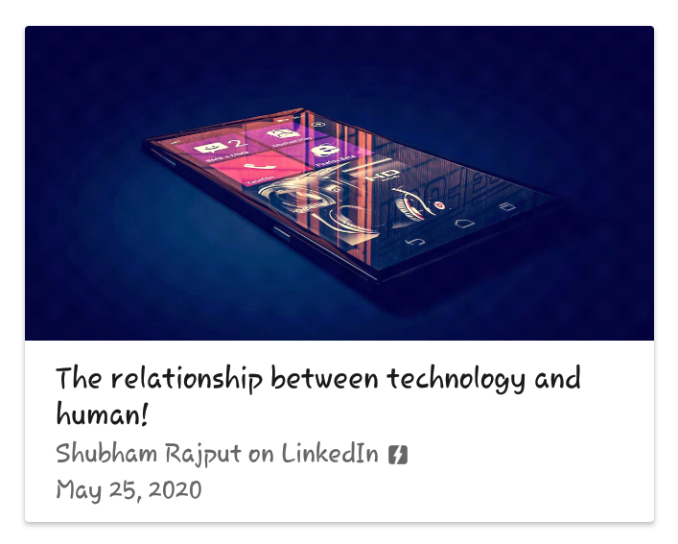
RESEARCH & ARTICAL
This is my world of enthusiastic efforts with technology and its nature of problem solving. I am continuously trying to contribute in research domain which helps us in solving the real world problems.
ABOUT
EDUCATION-1
EDUCATION-2
EXPERIENCE
RESEARCH 1
RESEARCH 2
India recently faced “Nisarga” cyclone! It was collapsed at the coastline of the Indian state of Maharashtra and Gujarat. This article demonstrate some important & efficient technological ways which can be help our India for strongly facing “Nisarga” cyclone aa well as from future disaster crisis with minimum damages.
This article demonstrate my thoughts about “Do we really need 5-G Technology in 2020?”. It also explains the scope of “5-G Technology” which is going to establish the strong world in tech domain.
It is my freelance efforts of studying the relationship as well as interference of technology in human life. How human can satisfy their needs using technology. It explains the philosophy of human with technology.
INTEREST
CONTACT

Slide 8






INTEREST & CARRIER
I want to become Web Developer, Data Analyst .
ABOUT
EDUCATION-1
EDUCATION-2
EXPERIENCE
RESEARCH 1
RESEARCH 2
INTEREST
CONTACT

Slide 9






CONTACT
PHONE
E-MAIL
ABOUT
+91-9422537016
+91-7666749962
shubham.rajput0369@gmail.com
shubhamrajputincep@gmail.com
EDUCATION-1
EDUCATION-2
LINKEDIN
GITHUB
EXPERIENCE
www.linkedin.com/in/shubhamrajput0369
www.github.com/shubhamrajput0369
RESEARCH 1
RESEARCH 2
PORTFOLIO
MEDIUM
INTEREST
https://shubhamrajput0369.github.io
https://medium.com/@shubhamrajput0369
CONTACT

